Slide 1
CSCI561 Spring 2017 Week 2 Discussion
Prof Sheila Tejada stejada@usc.edu
Prof Wei-min shen shen@usc.edu
Prof Ning wang Nwang@ict.usc.edu

Slide 2
Search and AI
It has been said that search is the fundamental activity in AI, that is, that almost all, if not all, AI systems involve search in some form or another.
Do you agree with that?
Can you think of examples of AI systems that don’t involve search?

Slide 3
Search in AI applications
Is search involved in these AI applications? If so, in what part or parts of the application?
Building a driverless car that will drive down a roadway. (Leave aside the search involved in route planning.)
Building a system like Siri.
Text-to-speech synthesis

Slide 4
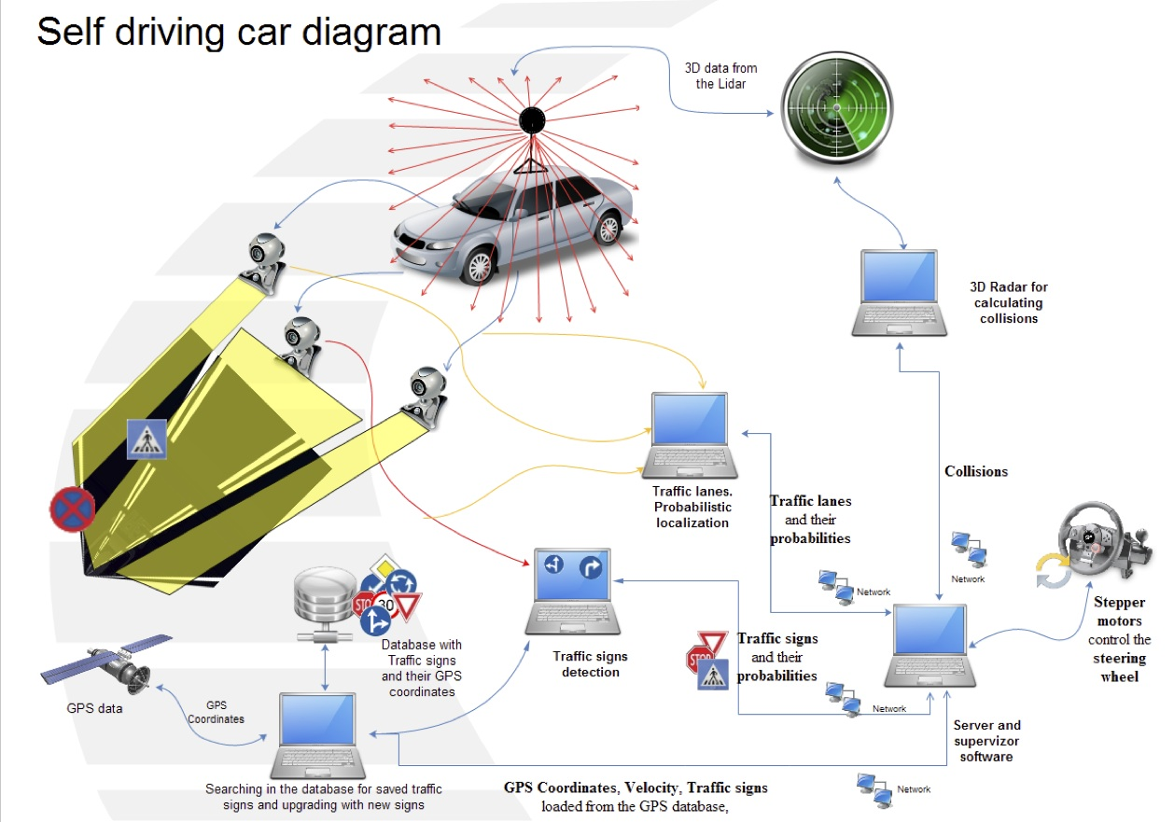

Slide 5
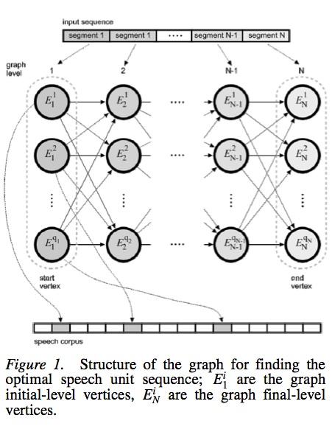
Search in AI applications
Is search involved in these AI applications? If so, in what part or parts of the application?
Building a driverless car that will drive down a roadway. (Leave aside the search involved in route planning.)
Building a system like Siri.
Text-to-speech synthesis

Slide 6
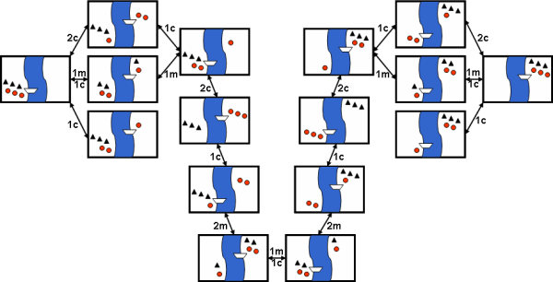
missionaries and cannibalS
Did you find that there was much search involved in finding a solution?
Why do people have a hard time solving this problem?
Notes:
There are a number of constraints on solutions to this problem, for example, the boat only holds one or two people, you can never have more cannibals than missionaries on either side of the river, etc. Constraints are generally thought of as making it harder to solve a problem, but could they make it easier? How?

Slide 7
Visualizing Orders of Growth
O(1): Constant growth
O(log(n)): Logarithmic growth
O(n): Linear growth
O(n^{k}): Polynomial growth, where k is a constant
O(2^{n}): Exponential growth
Try plot them out yourself:
https://www.desmos.com/calculator
www.wolframalpha.com

Slide 8
Time complexity of breadth-first search
Illustrates when goal check is done when node is selected for expansion
If a goal node is found on depth d of the tree, all nodes up till that depth are created and examined (note: and the children of nodes at depth d are created and queued, but not yet examined).
d
b
m
G
Thus: O(b^{d+1})

Slide 9
Space complexity of breadth-first search
Illustrates when goal check is done when node is selected for expansion
Largest number of nodes in FRONTIER is reached on the level d+1 just beyond the goal node.
d
b
G
QUEUE contains all nodes. (Thus: 4) .
In General: b^{d+1} – b ~ b^{d+1}

Slide 10
Time complexity of depth-first search
In the worst case:
the (only) goal node may be on the right-most branch,
d
m
b
G
Time complexity = b^{m} + b^{m-1} + … + 1 = O(b^{m})

Slide 11
Space complexity of depth-first
Largest number of nodes in FRONTIER is reached in bottom left-most node.
Example: m = 3, b = 3 :
G
...
FRONTIER contains all nodes. Thus: 6.
In General FRONTIER contains ((b-1) * m)
Order: O(m*b)

Slide 12
Graph Search
function GRAPH-SEARCH(problem) return a solution or failure
frontier ← MAKE-QUEUE(MAKE-NODE(problem.INITIAL-STATE))
explored_set ← empty
loop do
if EMPTY?(frontier) then return failure
node ← REMOVE-FIRST(frontier)
if problem.GOAL-TEST applied to node.STATE succeeds
then return SOLUTION(node)
explored_set ← INSERT(node, explored_set) for each new_node in EXPAND(node, problem) do if NOT(MEMBER?(new_node, frontier)) and NOT(MEMBER?(new_node, explored_set))
then frontier ← INSERT(new_node, frontier)

Slide 13
Search Graph
Notes:
a)DFS G1 (2%) _____ S­A­E­G1 ( 8%) [No partial credit]
b)UCS G3(2%) _____ S­C­D­B­G3( 8%) [No partial credit]
c)A* G3(2%) _____ S­B­C­D­G3 OR S­B­C­D­B­G3 (8%) [No partial credit]

Slide 14
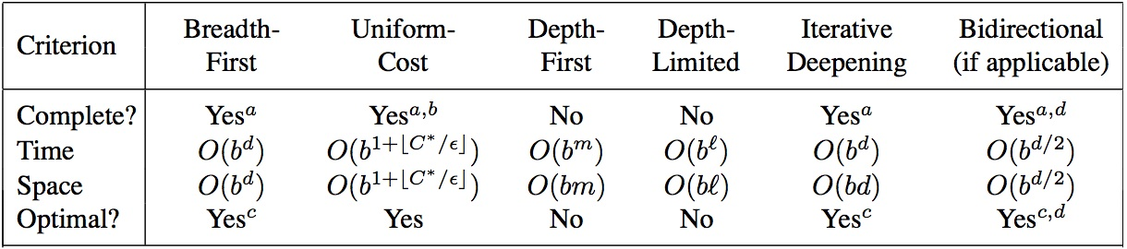
What you should know(Week2)
What is the difference between uninformed and
informed search? Which ones are optimal?
What are the advantages and disadvantages of depth-first search?
Be familiar with the differences between search strategies shown in Figure 3.21
Notes:
http://cse.unl.edu/~choueiry/S03-476-876/searchapplet/
https://courses.cs.washington.edu/courses/cse473/06sp/MazeRunnerDemo/search/applet.html
http://www.briangrinstead.com/files/astar/
http://www.cs.rmit.edu.au/AI-Search/Product/

Slide 15
Want more?
Check out these search comparison demos:
http://cse.unl.edu/~choueiry/S03-476-876/searchapplet/
https://courses.cs.washington.edu/courses/cse473/06sp/MazeRunnerDemo/search/applet.html
BigO and complexity:
https://apelbaum.wordpress.com/2011/05/05/big-o/

